Slide 1
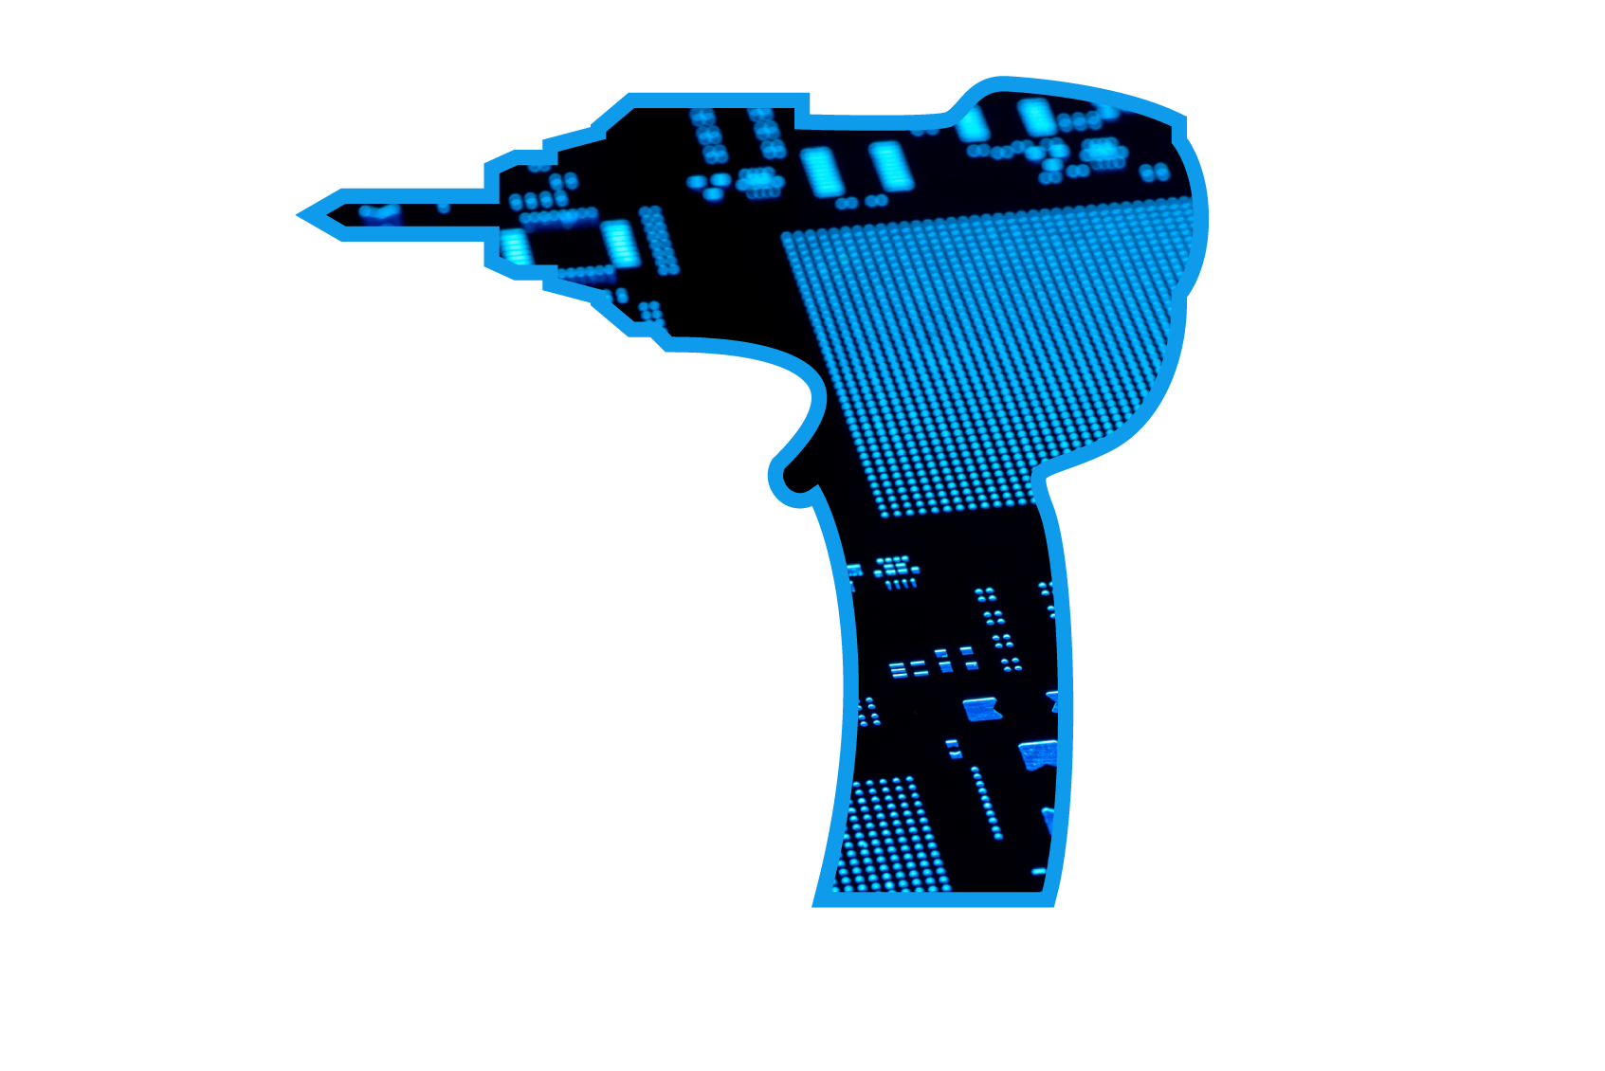
基于东芝核心器件的电动工具解决方案推荐
E-Tool
东芝电子（中国）有限公司
2018.05

Slide 2
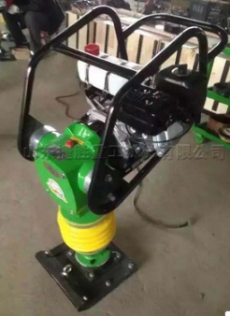
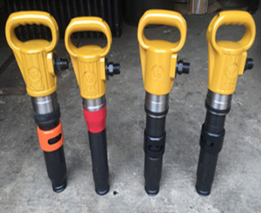
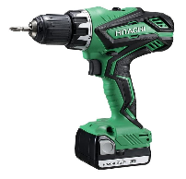
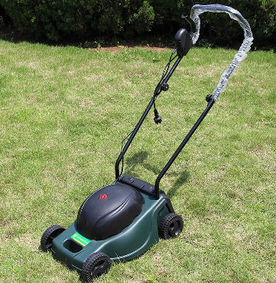

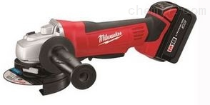
电动工具市场概略
电动工具
手持工具
园林工具
其他工具
电转
电锤
电扳手
手动园林工具
智能园林工具
角磨
……
……
150M sets/Y
30-40M sets/Y

Slide 3
电动工具技术发展趋势和东芝的产品应对
Market Requirement
➔
➔
E – Tool Technical Trend
➔
➔
Toshiba Proposal
Bigger
Power
& Torque
Motor
Higher Torque
& Power
Inverter
BLDC motor
Motor
Power Devices
Less Motor
Noise &
Vibration
Small Signal
Longer Time
operation
Less noise
& Vibration
Efficient
Motor driving
IOT &
Telemetry
Motor MCU
Motor Control Driver
IOT
Smart
More Stable
& Safety
Less
Weight
Bigger
Battery
Fail Safety
design
New Technology
LSSL Motor Drive
(Low Speed Sensor Less)
Battery
Design
Policy
Smart E-Tool
Telemetry
Longer
Battery Life
Less Weight
Compact &
Small size
CCA for long battery life
(Charging Curve Analysis)

Slide 4
应对客户需求的东芝提案
Three-phase
brushless
motor drive
Low-loss,
low-heat,
and heat
efficiency
Compatible
with
compact
packages
Bipolar transistor
1
U-MOS series power MOSFET
2
DTMOS IV series power MOSFET
3
Small signal MOSFET
4
Ultra low-noise op-amp
5
Small surface-mounted LDO
6
Transistor-output photocoupler
7
Three phase MCD
8
Motor MCU and Microcontroller
9

Slide 5
电动工具系统方框图

Slide 6
马达驱动及主控电路
01

Slide 7
主控系统方框图

Slide 8
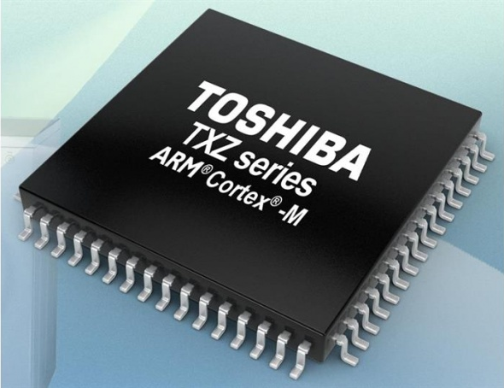
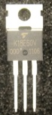
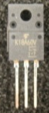

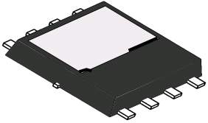
主控系统方案构成（Motor MCU＋Gate Driver＋MOSFET）
Motor MCU (TMPM4K series)
TPH1R204PB／40V
TPH1R306P1／60V
Low spike technology
Low RDS(ON)
LV MOSFET (U-MOS-IX-H series)
ARM Cortex-M4
WDT
A-PMD
U | X
V | Y
W | Z
MOSFET
MOSFET
MOSFET
Gate Driver
Code
Flash
MPU
A-VE+
M
IOSC
SCLK／SDI／SDO／FSS
MOSFET
MOSFET
MOSFET
POR
OFD
ADC
OP-AMP
Current sense signal (3ch)
SRAM
RAM
Scope
I/F
A-ENC
Hall signal
(Hu,Hv,Hw)
Timer
U-MOS VIII／IX-H series
U-MOSⅨ-H: 30V, 40V, 45V, 60V, 100V
40V low spike, 60V low spike
U-MOSⅧ-H: 30V, 40V, 60V, 75V, 80V, 100V,
120V, 150V, 200V, 250V
Operation frequency： 80M – 160MHz
Operation temperature： - 40℃ ～ +105℃
Built in motor control circuit：A-VE+, A-PMD，A-ENC
Built in high speed 12bit ADC(<0.5μs) & OP AMP(10V/μs)
Square-wave driver or Sine-wave driver
PKG: 32, 44, 48, 64, 80, 128 Pin
Compliant to safety standard (IEC60730) and compatible with RAMScope
IEC60730-compliant mechanism for checking ROM, RAM, AD, and clock.
Compatible with a RAMScope(*); supporting a debugging function
Wide variety of packages
TSON Advance
SOP Advance
DSOP Advance
TO-220
TO-220SIS
3 x 3
5 x 6
5 x 6

Slide 9
东芝带矢量引擎马达MCU系列及电动工具应用推荐
MP
ROM
PKG
41 Products
TXZ Family
Cortex®-M4 @160MHz
11 Products
**TMPM4KQ
128~512K
144pin
TX Family
Cortex®-M4 @120MHz
**TMPM4KP
128~512K
128pin
Motor Processing Performance
TMPM470
256～512K
100pin
Cortex®-M3 @80MHz
**TMPM4KN
128~512K
100pin
TMPM475
256～ 512K
100pin with CAN
TMPM376FD
512K
100pin
**TMPM4KM
128~512K
80pin
TX04 series
TMPM370FY
256K
100pin
**TMPM4KL
128~512K
64pin
Cortex®-M4 @80MHz
Performance Up
New PMD, High-Speed ADC
Safety functions
**TMPM4K4
64~256K
64pin
**TMPM4K2
64~256K
48pin
Cortex®-M3 @80MHz
**TMPM4K1
64~256K
44pin
TMPM372FW
128K
64pin
**TMPM4K0
64K
32pin
TMPM373FW
128K
48pin
TXZ4 series
TMPM374FW
128K
44pin
Built in
Pre-driver(30V)
Cortex®-M3 @40MHz
TMPM375FS
64K
30pin
TMPM37AFS
64K
QFN32pin
TX03 series
Note: As products are in planning stage or under development,
the information contained herein is subject to change without notice.
~2015
2016
2017～

Slide 10
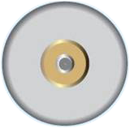
TMPM4K系列产品中的矢量引擎
Toshiba proprietary hardware Vector Engine VE execute vector control calculation automatically and closely interlocking with the ３-phase PWM timer and AD converter, without software process
①
②
CPU
Vector Engine
VE
3-phase PWM
PMD
Inverter
Current command
Phase estimation
③
Inverter
⑤
④
Current
detection
ADC
Software
Hardware
(note) Toshiba estimation
Vector Engine VE reduces CPU load by 73% (note)
  MCU enable to Save power consumption
  MCU enable to Perform more advanced feature other than motor control

Slide 11
LSSL技术及其优势
What is LSSL (Low Speed Sensor-less) ?
  Toshiba proprietary technology to control motor at low speed without position sensors.
Merit of LSSL?
  Improve inverter efficiency & motor efficiency
  Reduce power consumption
  Boot a motor under heavy load
Key control spec for E-Tool motor:
  Low sound noise
  Low power consumption
  Constant torque output/constant speed running
  Over current detection & protection
  Over / Low voltage detection & protection
  Lost position detection & protection
  Block detection & protection
Improved
by LSSL
Improved
by LSSL
LSSL will be ready on “TMPM4K series Reference design” in 2019/3Q

Slide 12
TMPM4K系列产品在多路马达驱动系统中的应用
Motor MCU（ TMPM4K2 ）
Arm ® Cortex ® -M4
WDT
A-PMD
U | X
V | Y
W | Z
MOSFET
MOSFET
MOSFET
Gate Driver
Code
Flash
MPU
A-VE+
M
IOSC
POR
OFD
ADC
U | X
V | Y
W | Z
MOSFET
MOSFET
MOSFET
OP-AMP
Gate Driver
SRAM
RAM
Scope
I/F
A-ENC
Timer
MOSFET
MOSFET
MOSFET
TMPM4K系列MCU有两个产品组，
组1中的M4K2-M4K4支持2通道PMD，
组2中产品全部支持3通道PMD
此类产品特别适合于在多马达驱动系统中应用
M
MOSFET
MOSFET
MOSFET

Slide 13
东芝M4K产品系列，群1功能列表
 |  | M4K0 | M4K1 | M4K2 | M4K4
Basic Features | CPU | Arm Cortex-M4 (Single-precision floating-point execution unit)
 | Max. frequency | 80MHz
 | Built-in oscillation frequency | 10MHz (+/- 1.0%)^{(※2)}
 | Data Flash | -
 | Number of I/O | 22 | 34 | 38 | 52
 | External interrupt | 6 | 9 | 10 | 11
Timer | 32(16)-bit timer | 6(12)
 | Watchdog timer | Yes
 | PWM output 32(16)-bit | 2(2) | 5(6) | 5(6) | 6(7)
 | RTC | -
Analog | 12-bit ADC (input Ch/Units) Minimum conversion time :0.5μsec^{※1} | 6/1 | 10/1 | 11/1 | 13/1
 | Op-amp | 1 | 3
Communication | UART | 2 | 2 | 3 | 4
 | TSPI(SPI/SIO) | 1 | 2 | 2 | 4
 | I2C | - | 1 | 1 | 1
Peripheral circuits | Advanced-VE+ Vector Engine | 1
 | DMA (Ch/Unit) | 32/1
 | Advanced PMD (3-phase complementary PWM output) | 1 |  | 2
 | Advanced Encoder input | 1
Supply Voltage |  | 2.7～5.5V
Package | Pin count | 32 | 44 | 48 | 64
※1) AVDD=4.5～5.5V ※2) Factory Default Warranty.
Note: As products are in planning stage or under development, the information contained herein is subject to change without notice.

Slide 14
东芝M4K产品系列，群2产品列表
 |  | M4KL | M4KM | M4KN | M4KP | M4KQ
Basic Features | CPU | Arm Cortex-M4 (Single-precision floating-point execution unit)
 | Max. frequency | 160MHz
 | Built-in oscillation frequency | 10MHz (+/- 1.0%)^{(※2)}
 | Data Flash | 32KB
 | Number of I/O | 52 | 68 | 88 | 116 | 132
 | External interrupt | 20 | 23 | 25 | 26 | 27
Timer | 32(16)-bit timer | 5(10) | 6(12) | 6(12) | 6(12) | 6(12)
 | Watchdog timer | Yes
 | PWM output 32(16)-bit | 5(9) | 6(10) | 6(11) | 6(12) | 6(12)
Analog | 12-bit ADC (input Ch/Units) Minimum conversion time :1.0μsec^{※1} | 14/3 | 17/3 | 22/3 | 32/3 | 32/3
 | Op-amp | 3 | 3 | 3 | 3 | 3
Communication | UART | 3 | 4 | 4 | 4 | 4
 | TSPI(SPI/SIO) | 2 | 2 | 2 | 2 | 2
 | I2C | 2 | 2 | 2 | 2 | 2
 | CAN | - |  | 1 | 1 | 1
Peripheral circuits | Advanced-VE+ Vector Engine | 1 | 1 | 1 | 1 | 1
 | DMA (Ch/Unit) | 32/1 | 32/1 | 32/1 | 32/1 | 32/1
 | Advanced PMD (3-phase complementary PWM output) | 3 | 3 | 3 | 3 | 3
 | Advanced Encoder input | 1 | 2 | 3 | 3 | 3
Supply Voltage |  | 2.7～5.5V
Package | Pin count | 64 | 80 | 100 | 128 | 144
※1) AVDD=4.5～5.5V ※2) Factory Default Warranty.
Note: As products are in planning stage or under development, the information contained herein is subject to change without notice.

Slide 15
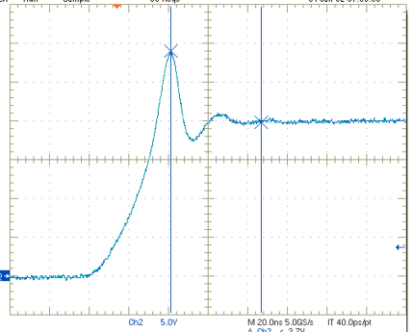
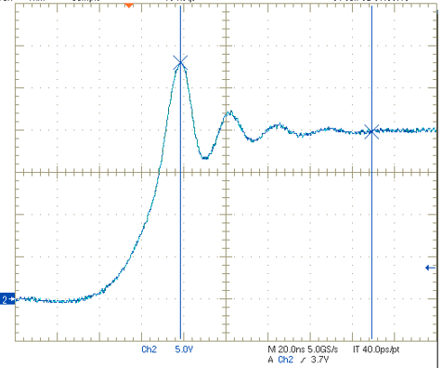
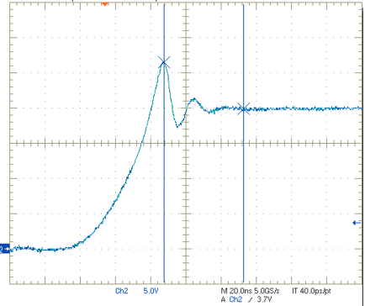
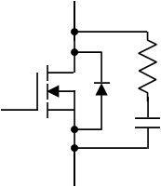

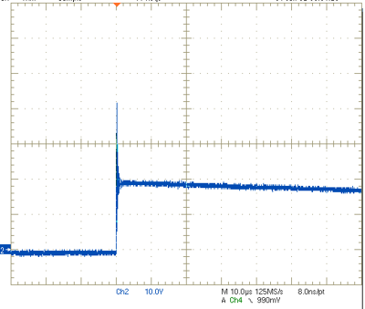
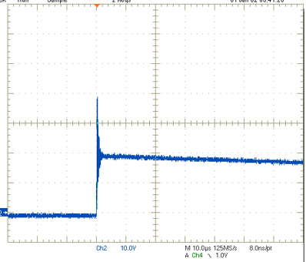


U-MOSⅨ-H 40V系列＋低尖峰技术
TPH1R204PB ：兼具U-MOS Ⅸ-H的高性能和低尖峰特性
Waveform comparison (VDSS＝40V Type.）
Low Spike Technology
Infineon
TOSHIBA
TOSHIBA
BSC010N04LSI
TPH1R204PL
TPH1R204PB
TPH1R204PB(40V)
Switching waveform
VDD＝20V，ID＝50A
RG＝4.7Ω，RGS＝4.7Ω
Resistance load
Ta＝25℃
29.0V
28.0V
MP
26.5V
6V drive
VDS：5V/div
Drain
Snubber
20ns/div
Gate
Adjust
snubber
constant
VDS：10V/div
trr waveform
VDD＝20V
IDR＝37.5A
di/dt＝160A/μs
Ta＝25℃
41.6V
39.4V
28.0V
Source
10us/div
TPH1R204PB has lower VDS spike than BSC010N04LSI does in switching and trr waveforms.
*Qrr ：Infineon : 400A/μs TOSHIBA ： 100A/μs

Slide 16
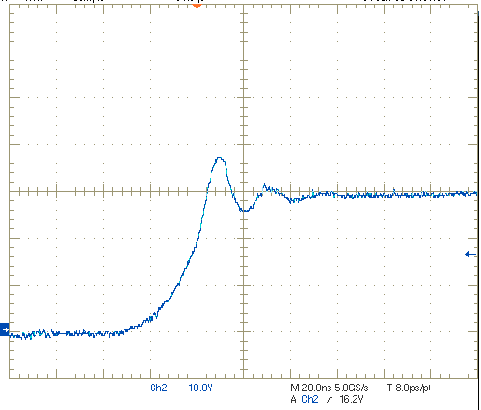
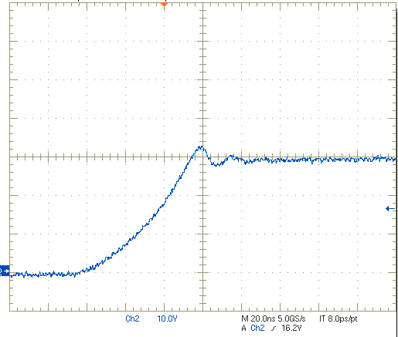
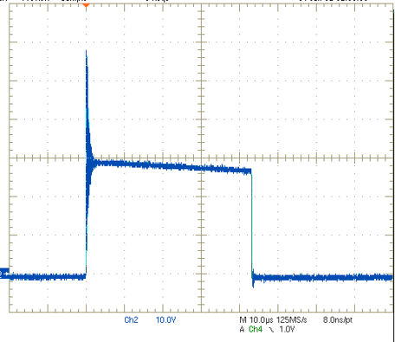
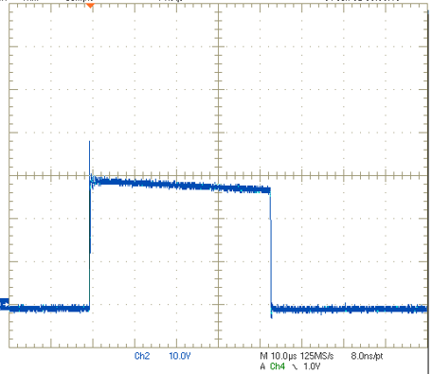
U-MOSⅨ-H 60V系列＋低尖峰技术
TPH1R306P1：兼具U-MOS Ⅸ-H的高性能和低尖峰特性
Waveform comparison (VDSS＝60V type.）
Low Spike Technology
TPH1R306PL
TPH1R306P1
TPH1R306P1(60V)
Switching waveform
VDD＝30V，ID＝50A
RG＝4.7Ω，RGS＝4.7Ω
Resistance load
Ta＝25℃
MP
36.8V
4.5V drive
31.9V
VDS：10V/div
Drain
Snubber
20ns/div
Gate
Adjust
snubber
constant
trr wavefrom
VDD＝30V
IDR＝25A
di/dt＝220A/μs
Ta＝25℃
59.2V
VDS：10V/div
38.2V
Source
10us/div
TPH1R306P1 has lower V_{DS} spike than BSC010N04LSI does in switching and trr waveforms.

Slide 17
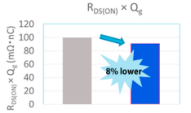
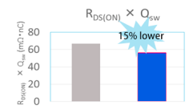
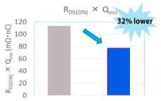
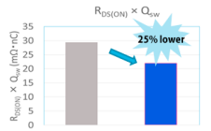
U-MOSⅨ-H 60V系列
U-MOSIX-H 60V系列为您提供同等产品中最好的性能及明显效率的改善
Low drive losses
Switching losses
Output charge losses
RDS(ON)×Qg reduction
(Cell design optimization)
Large contribution at high
frequency, especially in light load
RDS(ON)×Qg reduction
(Cell design optimization)
Large contribution at high
frequency, especially in light load
RDS(ON)×Qg reduction
(Cell design optimization)
* Loss reduction of high-side MOSFET
when used in low side of totem pole
FOM Comparison with Infineon OptiMOS5
FOM：Figure of Merit
As of January 2018 (as surveyed by Toshiba)
Conduction and drive losses
Conduction and switching losses
Conduction and output charge losses
OptiMOS5
(BSC014N06NS)
U-MOSIX-H
(TPH1R306PL)
OptiMOS5
(BSC014N06NS)
U-MOSIX-H
(TPH1R306PL)
OptiMOS5
(BSC014N06NS)
U-MOSIX-H
(TPH1R306PL)
RDS(ON)：On-resistance (figure of merit for conduction loss)
Qg：Gate charge (figure of merit for drive loss)
Qsw：Gate switch charge (figure of merit for switching loss)
Qoss：Output charge (figure of merit for output charge loss)

Slide 18
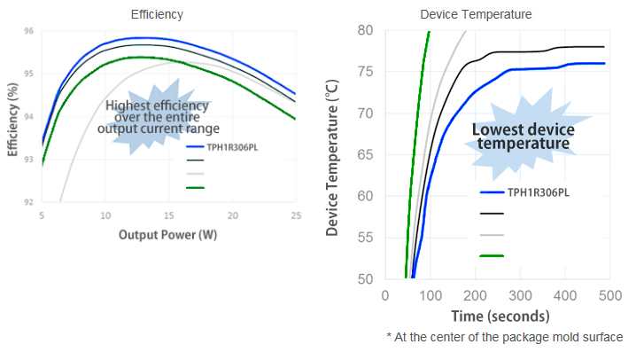
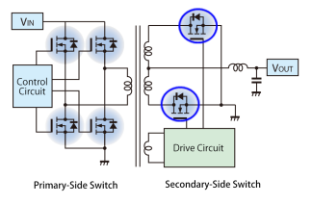


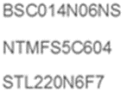
60V LVMOS的效率比较（Toshiba U-MOS Ⅸ-H VS Infineon OptiMOS5）
在4个MOSFET中TPH1R306PL具有同类产品最好的性能
Full-bridge DC-DC converter
Input voltage＝48V
Output voltage＝24V
Operating frequency＝160kHz
MOSFET gate drive voltage＝6V
Part Number | RDS(ON) (mΩ) |  | Ciss (pF) | Crss (pF) | Coss (pF) | Rg (Ω)
 | @10V | @4.5
TPH1R306PL | 1.34 | 2.3 | 6250 | 80 | 1160 | 0.5
BSC014N06NS | 1.45 | 2.2(6V) | 6500 | 59 | 1500 | 2
NTMFS5C604 | 1.2 | 1.7 | 8900 | 40 | 3750 | (2)*
STL220N6F7 | 1.4 | － | 6600 | 250 | 3100 | (1.5)*
<Test device>
TPH1R306PL (TOSHIBA U-MOSⅨ-H)
BSC014N06NS (Infineon OptiMOS5)
NTMFS5C604 (ON Semi)
STL220N6F7 (ST Micro)
*Tested by TOSHIBA

Slide 19
LVMOS产品列表（VDSS＝40V）

Slide 20
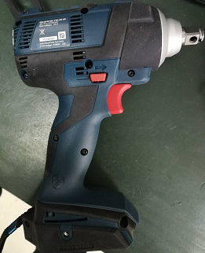
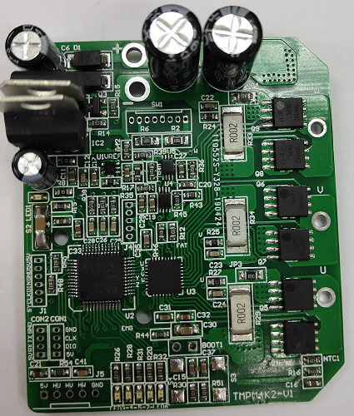
参考样机特性
Cordless E-tool characteristics :
>> Rated power: 300W
>> Voltage: 18V (16.8 ~ 21V)
>> Rated current: 20A
>> PWM frequency: 16kHz
>> Motor speed: 1,000 ~ 20,000 rpm
Cordless E-tool Motor driver method:
With sensor
>> Square wave driver
>> Sine wave driver
Sensor-less BLDC motor
>> FOC driver
Board is inside
Other function:
Support:
>> Speed control
>> Direction in CW or CCW
>> Motor on/off
>> Protection: over current, lost position, over / under voltage, over temperature

Slide 21
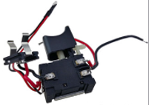
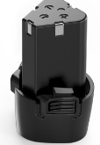
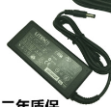
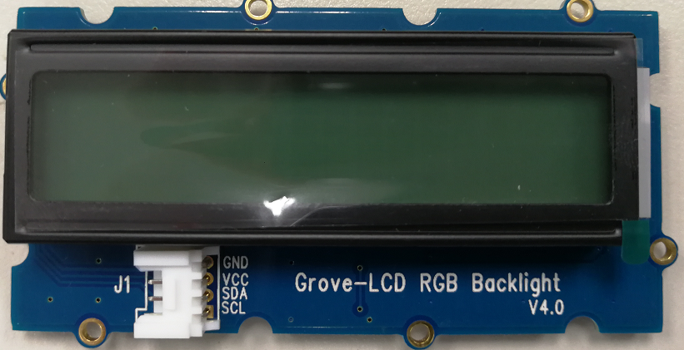
参考样机系统方框图及主板
Power supply
Switch
Size：5cm×6cm
Battery
+18V
LDO
+18V
Speed setting
Direction setting
etc
U, V, W signal
to motor
+5V
AC/DC adapt
ADC
Power supply
GPIO
M4K2
DAC module
SPI
Pre-driver
MOSFET×6
TPH1R204PB
MOSFET: TPH1R204PB x 6
PMD
Protection
detect
ADC
SPI
LED Lamp
GPIO
M
ADC
LED module
“8888”
I2C
Current detection：
Internal amplifier
MCU: TMPM4K2FSAUG
(With 3ch internal Amp)
OPAMP
J-Link
Debug
Position signal：
Hall sensor
I²C interface
for display module
Host
UART
ENC/GPIO

Slide 22
电源管理及电池充电
02

Slide 23
电源管理及电池充电
Criteria for device selection
High withstand voltage and low ON resistance MOSFET is suitable for AC / DC power PFC circuit.
In general, a photocoupler is used for voltage feedback to the primary side to the AC / DC power supply.
AC/DC電源への一次側への電圧フィードバックには一般的にフォトカプラが使用されている。
电源系统方框图
4
Proposal from Toshiba
Epitaxial-type silicon bipolar transistor for gate driving
DTMOS IV MOSFET, ideal for high-efficiency power switching
Small signal MOSFET for low voltage switching
Ultra low-noise op-amp to capture fluctuations in current consumption accurately
Transistor-output photocoupler with superior environmental resistance
3
1
4
1
3
4
7
5
5
7

Slide 24
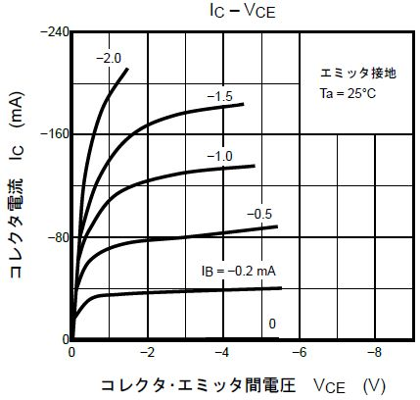


东芝提供多种封装覆盖宽泛应用范围的高性能晶体管
1
硅外延型双极型晶体管
TMBT3906／TMBT3904／2SC4116
High withstand voltage (rated collector loss)
Large current
(rated collector current)
Enhancement type
Because of the high withstand voltage, it can tolerate large loads and instantaneous voltage changes.
It also contributes to countermeasures against product life.
We provide a variety of packages covering a wide range of applications from high-frequency to power supply usages, particularly for products requiring high current capability.
Because it is an enhancement type where no collector current flows when there is no base voltage, the device is easy to operate.
High withstand voltage and high current are realized, making it ideal for low frequency amplification
(TMBT3904: Maximum）
High withstand voltage：VCEO＝-50V
High current：IC＝-150mA
Part number | TMBT3906 | TMBT3904 | 2SC4116
Package | SOT23 | SOT23 | USM
VCEO (Min.) [V] | -50 | 50 | 50
IC (Max.) [mA] | -150 | 150 | 150
VCE(SAT) (Max.) [V] | -0.25 | 0.2 | 0.25
hFE (Max.) | 300 | 300 | 700
Polarity | PNP | NPN | NPN

Slide 25
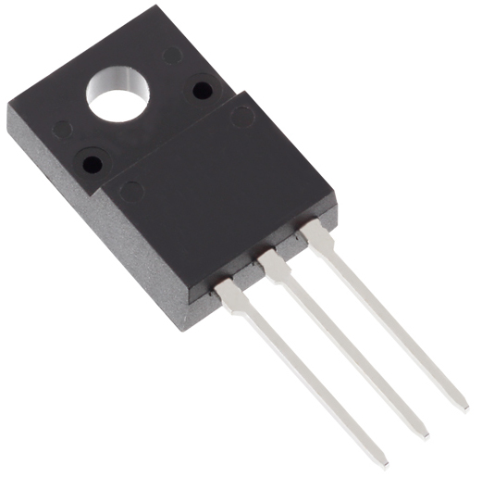
DTMOSIV系列功率MOSFETT（K12A60W／TK10A60W／TK17A80W）
3
降低30%的Ron·A性能指标(与传统产品比较), 改善电源效率，为产品的小型化作出贡献
Ron x A 30% reduction
Reduction of ON-resistance increase at high temperatures
Optimization of gate switching speed
Adoption of newly developed single-epitaxial process to reduce the performance index Ron x A by 30%.
(Compared with DTMOS III products from Toshiba)
The single epitaxial process reduces the ON-resistance increase at high temperatures.
Optimization of gate switching speed has been achieved by reduction of Coss (by 12%, compared with conventional products) and low ON-resistance (using super-junction DTMOS structure).
1
30%
Reduction
Part number |  | TK12A60W | TK10A60W | TK17A80W
Package |  | TO-202SIS | TO-202SIS | TO-202SIS
VDSS [V] |  | 600 | 600 | 800
ID [A] |  | 11.5 | 9.7 | 17
RDS(ON) @VGS＝10V[Ω] | Typ. | 0.265 | 0.327 | 0.25
 | Max. | 0.3 | 0.38 | 0.29
0.7
RON x A(Index)
DTMOS III
DTMOS IV
◆Block Diagram TOPへ戻る

Slide 26
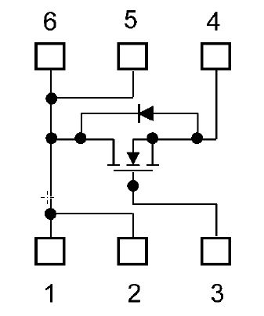

小信号、MOSFET（SSM6K513NU／SSM6N55NU／SSM6J507NU）
4
适用于小功率开关，较低的导通阻抗，较小的封装有利于减小PCB面积
Driving by low voltage
Low ON resistance
Small package
Can be driven by VDS＝4.5V
Heat dissipation and power consumption can be reduced by low ON resistance between source and drain.
Packaged in SOT-1220(2.0mm×2.0mm) form factor
Internal circuit
SSM6K513NU
Part number |  | SSM6K513NU | SSM6N55NU | SSM6J507NU
Package |  | UDFN6B | UDFN6B | UDFN6B
Polarity |  | Nch | Nch x２ | Pch
VDSS [V] |  | 30 | 30 | -30
ID [A] |  | 15 | 4 | -10
RDS(ON) @VGS＝4.5V [mΩ] | Typ. | 8.0 | 48 | 19
 | Max. | 12 | 64 | 28

Slide 27

超级低噪声运算放大器（TC75S67TU）
5
因超低的噪声可检出微小信号并放大
Ultra low noise
VNI(Typ.) ＝6.0 [nV/√Hz]
＠f＝1kHz
Low current consumption
IDD(Typ.)＝430[μA]
Low voltage operation
Very small signals detected by various sensors [Note 1] can be amplify with low noise using CMOS op-amp by optimizing the processing, we achieved one of the industry's lowest [note 2] input equivalent noise voltage.
The low current consumption characteristics of the CMOS processing contributes to the extension of battery life of the compact IoT devices [Note 3].
Can be operated in case of
VDD＝2.2V〜5.5V.
Ultra low noise
characteristics
Part number | TC75S67TU
Package | UFV
VDD，SS (Max.) [V] | ±2.75
VDD，SS (Min.) [V] | ±1.1
IDD (Max.) [μA] | 700
VNI (Typ.) @f＝1kHz [nV/√Hz] | 6
(Toshiba comparison)
Equivalent input noise voltage V_{IN}
(nV/√Hz)
Previous product：TC75S63TU
TC75S67TU
Frequency f(Hz)
VNI - f
[Note 1] Sensor types: vibration detection sensor, shock sensor, accelerometer, pressure sensor, infrared sensor, temperature sensor
[Note 2] Based on Toshiba data (May 2017).
[Note 3] Compared with Toshiba's op-amps using bipolar processing

Slide 28
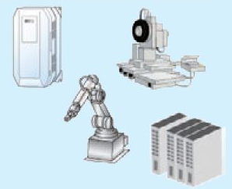

晶体管输出光耦（TLP385）
7
减少PCB面积、提高可
High conversion efficiency (IF＝0.5mA)
Operation guaranteed up to 110°C ambient temperature
This is a high-isolation photocoupler that optically couples a phototransistor and a GaAs infrared light emitting diode, achieving a higher conversion efficiency than conventional electromagnetic relays and insulating transformers.
It is designed to operate even under severe temperature environments such as those for inverter devices, robots, machine tools, and high-output power supplies.
High level of insulation and noise blocking
Industrial equipment
Part number | TLP385
Package | 4pin SO6L
Withstand voltage BVS (Min) [Vrms] | 5000
Operating Temparature Topr [deg.C] | -55 to 110
General-purpose inverter
Servo amplifier
Robot
Machine Tool
High-output power supply
Security equipment
Semiconductor tester
PLC (Programmable Logic Controller)

Slide 29
If you are interested in these products and
have questions or comments about any of them,
please do not hesitate to contact us.
Toshiba website: https://toshiba-semicon-storage.com/cn/
© Toshiba Electronic Devices & Storage Corporation

Slide 30
Terms of use
This terms of use is made between Toshiba Electronic Devices and Storage Corporation (“We”) and customers who use documents and data that are consulted to design electronics applications on which our semiconductor devices are mounted (“this Reference Design”). Customers shall comply with this terms of use. Please note that it is assumed that customers agree to any and all this terms of use if customers download this Reference Design. We may, at its sole and exclusive discretion, change, alter, modify, add, and/or remove any part of this terms of use at any time
without any prior notice. We may terminate this terms of use at any time and for any reason. Upon termination of this terms of use, customers shall destroy this Reference Design. In the event of any breach thereof by customers, customers shall destroy this Reference Design, and furnish us a written confirmation to prove such destruction.
1. Restrictions on usage
  This Reference Design is provided solely as reference data for designing electronics applications. Customers shall not use this Reference Design for any other purpose, including without limitation, verification of reliability.
  This Reference Design is for customer's own use and not for sale, lease or other transfer.
  Customers shall not use this Reference Design for evaluation in high or low temperature, high humidity, or high electromagnetic environments.
  This Reference Design shall not be used for or incorporated into any products or systems whose manufacture, use, or sale is prohibited under any applicable laws or regulations.
2. Limitations
  We reserve the right to make changes to this Reference Design without notice.
  This Reference Design should be treated as a reference only. We are not responsible for any incorrect or incomplete data and information.
  Semiconductor devices can malfunction or fail. When designing electronics applications by referring to this Reference Design, customers are responsible for complying with safety standards and for providing adequate designs and safeguards for their hardware, software and systems which minimize risk and avoid situations in which a malfunction or failure of semiconductor devices could cause loss of human life, bodily injury or damage to property, including data loss or corruption. Customers must also refer to and comply with the latest versions of all relevant our information, including without limitation, specifications, data sheets and application notes for semiconductor devices, as well as the precautions and conditions set forth in the "Semiconductor Reliability Handbook".
  When designing electronics applications by referring to this Reference Design, customers must evaluate the whole system adequately. Customers are solely responsible for all aspects of their own product design or applications. WE ASSUME NO LIABILITY FOR CUSTOMERS' PRODUCT DESIGN OR APPLICATIONS.
  No responsibility is assumed by us for any infringement of patents or any other intellectual property rights of third parties that may result from the use of this Reference Design. No license to any intellectual property right is granted by this terms of use, whether express or implied, by estoppel or otherwise.
  THIS REFERENCE DESIGN IS PROVIDED "AS IS". WE (a) ASSUME NO LIABILITY WHATSOEVER, INCLUDING WITHOUT LIMITATION, INDIRECT, CONSEQUENTIAL, SPECIAL, OR INCIDENTAL DAMAGES OR LOSS, INCLUDING WITHOUT LIMITATION, LOSS OF PROFITS, LOSS OF OPPORTUNITIES, BUSINESS INTERRUPTION AND LOSS OF DATA, AND (b) DISCLAIM ANY AND ALL EXPRESS OR IMPLIED WARRANTIES AND CONDITIONS RELATED TO THIS REFERENCE DESIGN, INCLUDING WARRANTIES OR CONDITIONS OF MERCHANTABILITY, FITNESS FOR A PARTICULAR PURPOSE, ACCURACY OF INFORMATION, OR NONINFRINGEMENT.
3. Export Control
  Customers shall not use or otherwise make available this Reference Design for any military purposes, including without limitation, for the design, development, use, stockpiling or manufacturing of nuclear, chemical, or biological weapons or missile technology products (mass destruction weapons). This Reference Design may be controlled under the applicable export laws and regulations including, without limitation, the Japanese Foreign Exchange and Foreign Trade Law and the U.S. Export Administration Regulations. Export and re-export of this Reference Design are strictly prohibited except in compliance with all applicable export laws and regulations.
4. Governing Laws
  This terms of use shall be governed and construed by laws of Japan.

Slide 31
RESTRICTIONS ON PRODUCT USE
Toshiba Electronic Devices & Storage Corporation, and its subsidiaries and affiliates (collectively "TOSHIBA"), reserve the right to make changes to the information in this document, and related hardware, software and systems (collectively "Product") without notice.
This document and any information herein may not be reproduced without prior written permission from TOSHIBA. Even with TOSHIBA's written permission, reproduction is permissible only if reproduction is without alteration/omission.
Though TOSHIBA works continually to improve Product's quality and reliability, Product can malfunction or fail. Customers are responsible for complying with safety standards and for providing adequate designs and safeguards for their hardware, software and systems which Minimize risk and avoid situations in which a malfunction or failure of Product could cause loss of human life, bodily injury or damage to property, including data loss or corruption. Before customers use the Product, create designs including the Product, or incorporate the Product into their own applications, customers must also refer to and comply with (a) the latest versions of all relevant TOSHIBA information, including without limitation, this document, the specifications, the data sheets and application notes for Product and the precautions and conditions set forth in the "TOSHIBA Semiconductor Reliability Handbook" and (b) the instructions for the application with which the Product will be used with or for. Customers are solely responsible for all aspects of their own product design or applications, including but not limited to (a) deterMining the appropriateness of the use of this Product in such design or applications; (b) evaluating and deterMining the applicability of any information contained in this document, or in charts, diagrams, programs, algorithms, sample application circuits, or any other referenced documents; and (c) validating all operating parameters for such designs and applications. TOSHIBA ASSUMES NO LIABILITY FOR CUSTOMERS' PRODUCT DESIGN OR APPLICATIONS.
PRODUCT IS NEITHER INTENDED NOR WARRANTED FOR USE IN EQUIPMENTS OR SYSTEMS THAT REQUIRE EXTRAORDINARILY HIGH LEVELS OF QUALITY AND/OR RELIABILITY, AND/OR A MALFUNCTION OR FAILURE OF WHICH MAY CAUSE LOSS OF HUMAN LIFE, BODILY INJURY, SERIOUS PROPERTY DAMAGE AND/OR SERIOUS PUBLIC IMPACT ("UNINTENDED USE"). Except for specific applications as expressly stated in this document, Unintended Use includes, without limitation, equipment used in nuclear facilities, equipment used in the aerospace industry, medical equipment, equipment used for automobiles, trains, ships and other transportation, traffic signaling equipment, equipment used to control combustions or explosions, safety devices, elevators and escalators, devices related to electric power, and equipment used in finance-related fields. IF YOU USE PRODUCT FOR UNINTENDED USE, TOSHIBA ASSUMES NO LIABILITY FOR PRODUCT. For details, please contact your TOSHIBA sales representative.
Do not disassemble, analyze, reverse-engineer, alter, modify, translate or copy Product, whether in whole or in part.
Product shall not be used for or incorporated into any products or systems whose manufacture, use, or sale is prohibited under any applicable laws or regulations.
The information contained herein is presented only as guidance for Product use. No responsibility is assumed by TOSHIBA for any infringement of patents or any other intellectual property rights of third parties that may result from the use of Product. No license to any intellectual property right is granted by this document, whether express or implied, by estoppel or otherwise.
ABSENT A WRITTEN SIGNED AGREEMENT, EXCEPT AS PROVIDED IN THE RELEVANT TERMS AND CONDITIONS OF SALE FOR PRODUCT, AND TO THE MAXIMUM EXTENT ALLOWABLE BY LAW, TOSHIBA (1) ASSUMES NO LIABILITY WHATSOEVER, INCLUDING WITHOUT LIMITATION, INDIRECT, CONSEQUENTIAL, SPECIAL, OR INCIDENTAL DAMAGES OR LOSS, INCLUDING WITHOUT LIMITATION, LOSS OF PROFITS, LOSS OF OPPORTUNITIES, BUSINESS INTERRUPTION AND LOSS OF DATA, AND (2) DISCLAIMS ANY AND ALL EXPRESS OR IMPLIED WARRANTIES AND CONDITIONS RELATED TO SALE, USE OF PRODUCT, OR INFORMATION, INCLUDING WARRANTIES OR CONDITIONS OF MERCHANTABILITY, FITNESS FOR A PARTICULAR PURPOSE, ACCURACY OF INFORMATION, OR NONINFRINGEMENT.
GaAs (Gallium Arsenide) is used in Product. GaAs is harmful to humans if consumed or absorbed, whether in the form of dust or vapor. Handle with care and do not break, cut, crush, grind, dissolve chemically or otherwise expose GaAs in Product.
Do not use or otherwise make available Product or related software or technology for any military purposes, including without limitation, for the design, development, use, stockpiling or manufacturing of nuclear, chemical, or biological weapons or missile technology products (mass destruction weapons). Product and related software and technology may be controlled under the applicable export laws and regulations including, without limitation, the Japanese Foreign Exchange and Foreign Trade Law and the U.S. Export AdMinistration Regulations. Export and re-export of Product or related software or technology are strictly prohibited except in compliance with all applicable export laws and regulations.
Please contact your TOSHIBA sales representative for details as to environmental matters such as the RoHS compatibility of Product. Please use Product in compliance with all applicable laws and regulations that regulate the inclusion or use of controlled substances, including without limitation, the EU RoHS Directive. TOSHIBA ASSUMES NO LIABILITY FOR DAMAGES OR LOSSES OCCURRING AS A RESULT OF NONCOMPLIANCE WITH APPLICABLE LAWS AND REGULATIONS.

